Slide 1


Slide 2


Slide 3


Slide 4

The logo represents the connection
and unity of African and Canadian
communities, coming together to
share ideas, experiences, and perspectives.
LOGO
RATIONALE.

Slide 5
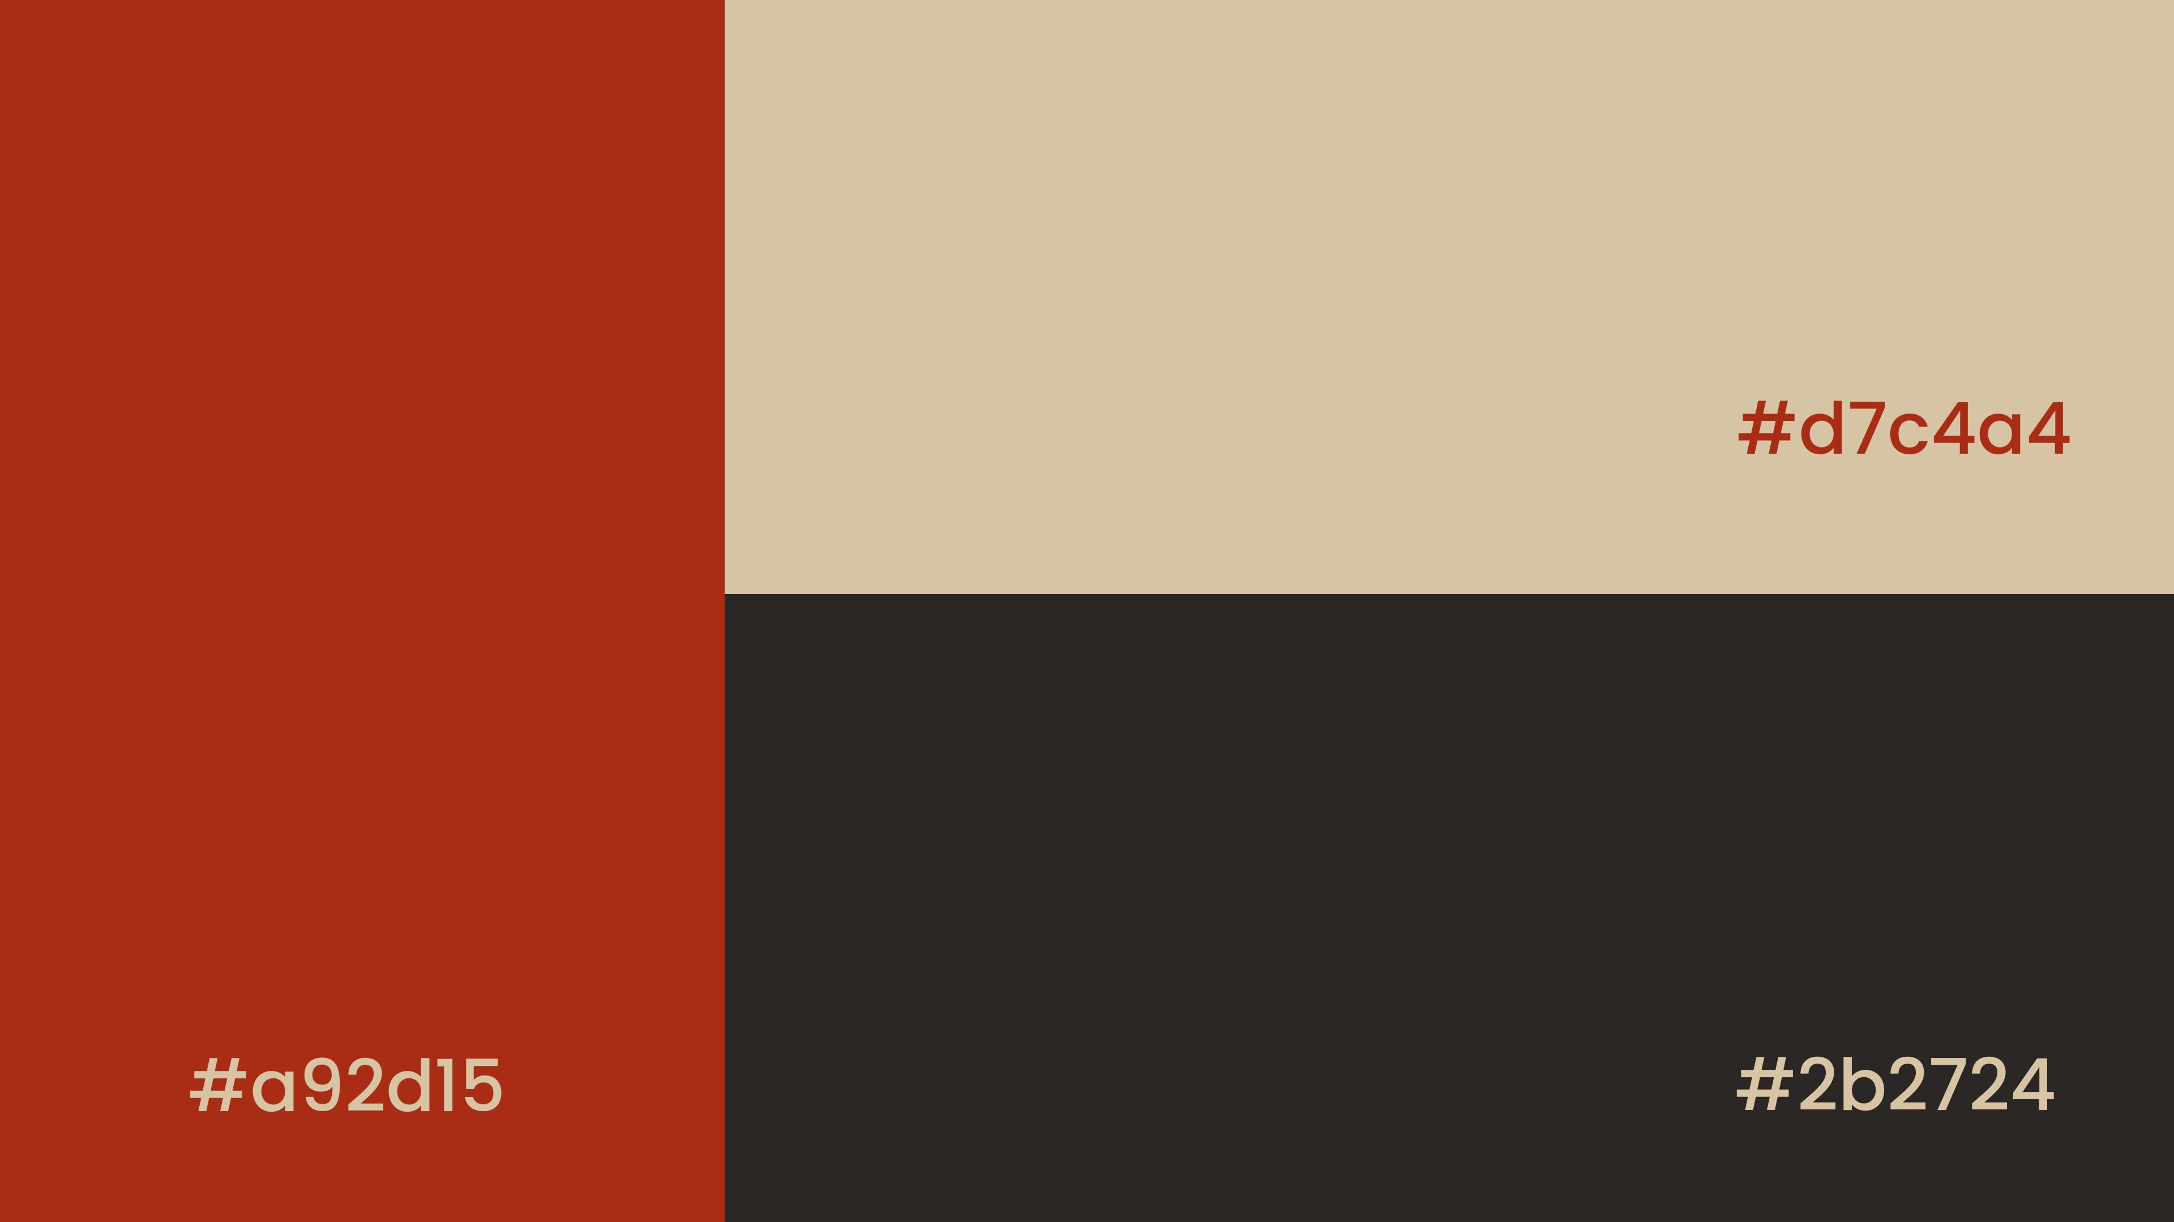

Slide 6
#a92d15 (Warm Earthy Red):
Represents passion, energy, and creativity.
Symbolizes the vibrant cultures and diversity of Africa.
Evokes feelings of warmth, excitement, and engagement.
#d7c4a4 (Soft Beige):
Represents neutrality, balance, and harmony.
Signifies the connection and unity between cultures.
Provides a calming and soothing contrast to the bold red.
#2b2724 (Deep Charcoal Grey):
Represents sophistication, elegance, and professionalism.
Symbolizes the modernity and innovation of Canada.
Adds depth and contrast to the design, grounding the other colors.
COLOR
RATIONALE.

Slide 7
Together, these colors create a visually appealing and meaningful palette that reflects the convergence of African and Canadian cultures, values, and innovations.
The warm red and deep grey tones create a sense of excitement and professionalism, while the soft beige provides a calming balance, representing the harmony and unity that the summit aims to achieve.
COLOR
RATIONALE.

Slide 8
Aa
Poppins is a modern sans-serif font that exudes:
Friendliness,
Modernity,
Legibility,
Versatility,
Professionalism.
By using Poppins, we’ve chosen a font that effectively communicates the Converge Summit’s values of innovation, approachability, and clarity, while also providing a clean and modern aesthetic.
Poppins
FONT

Slide 9
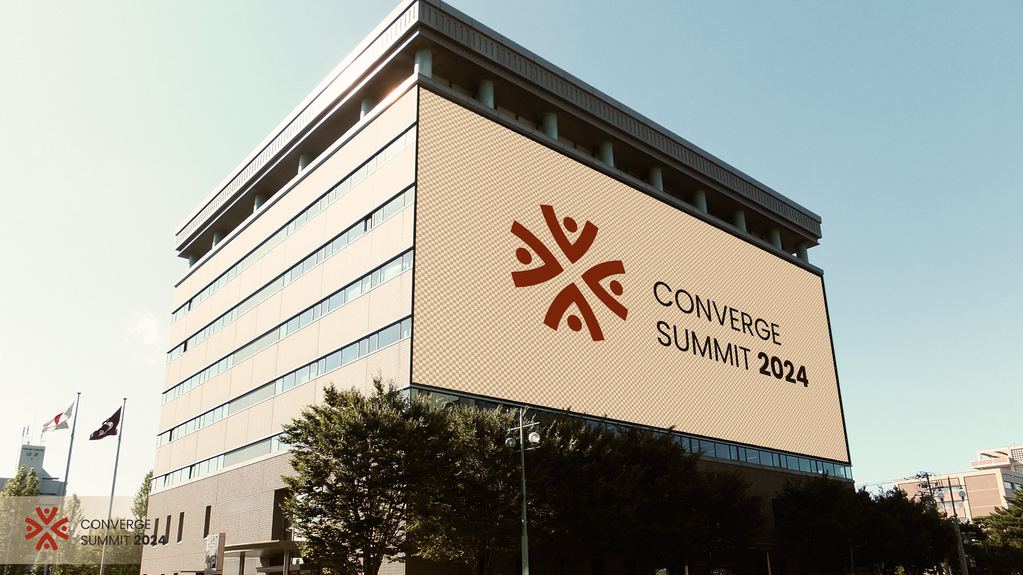

Slide 10
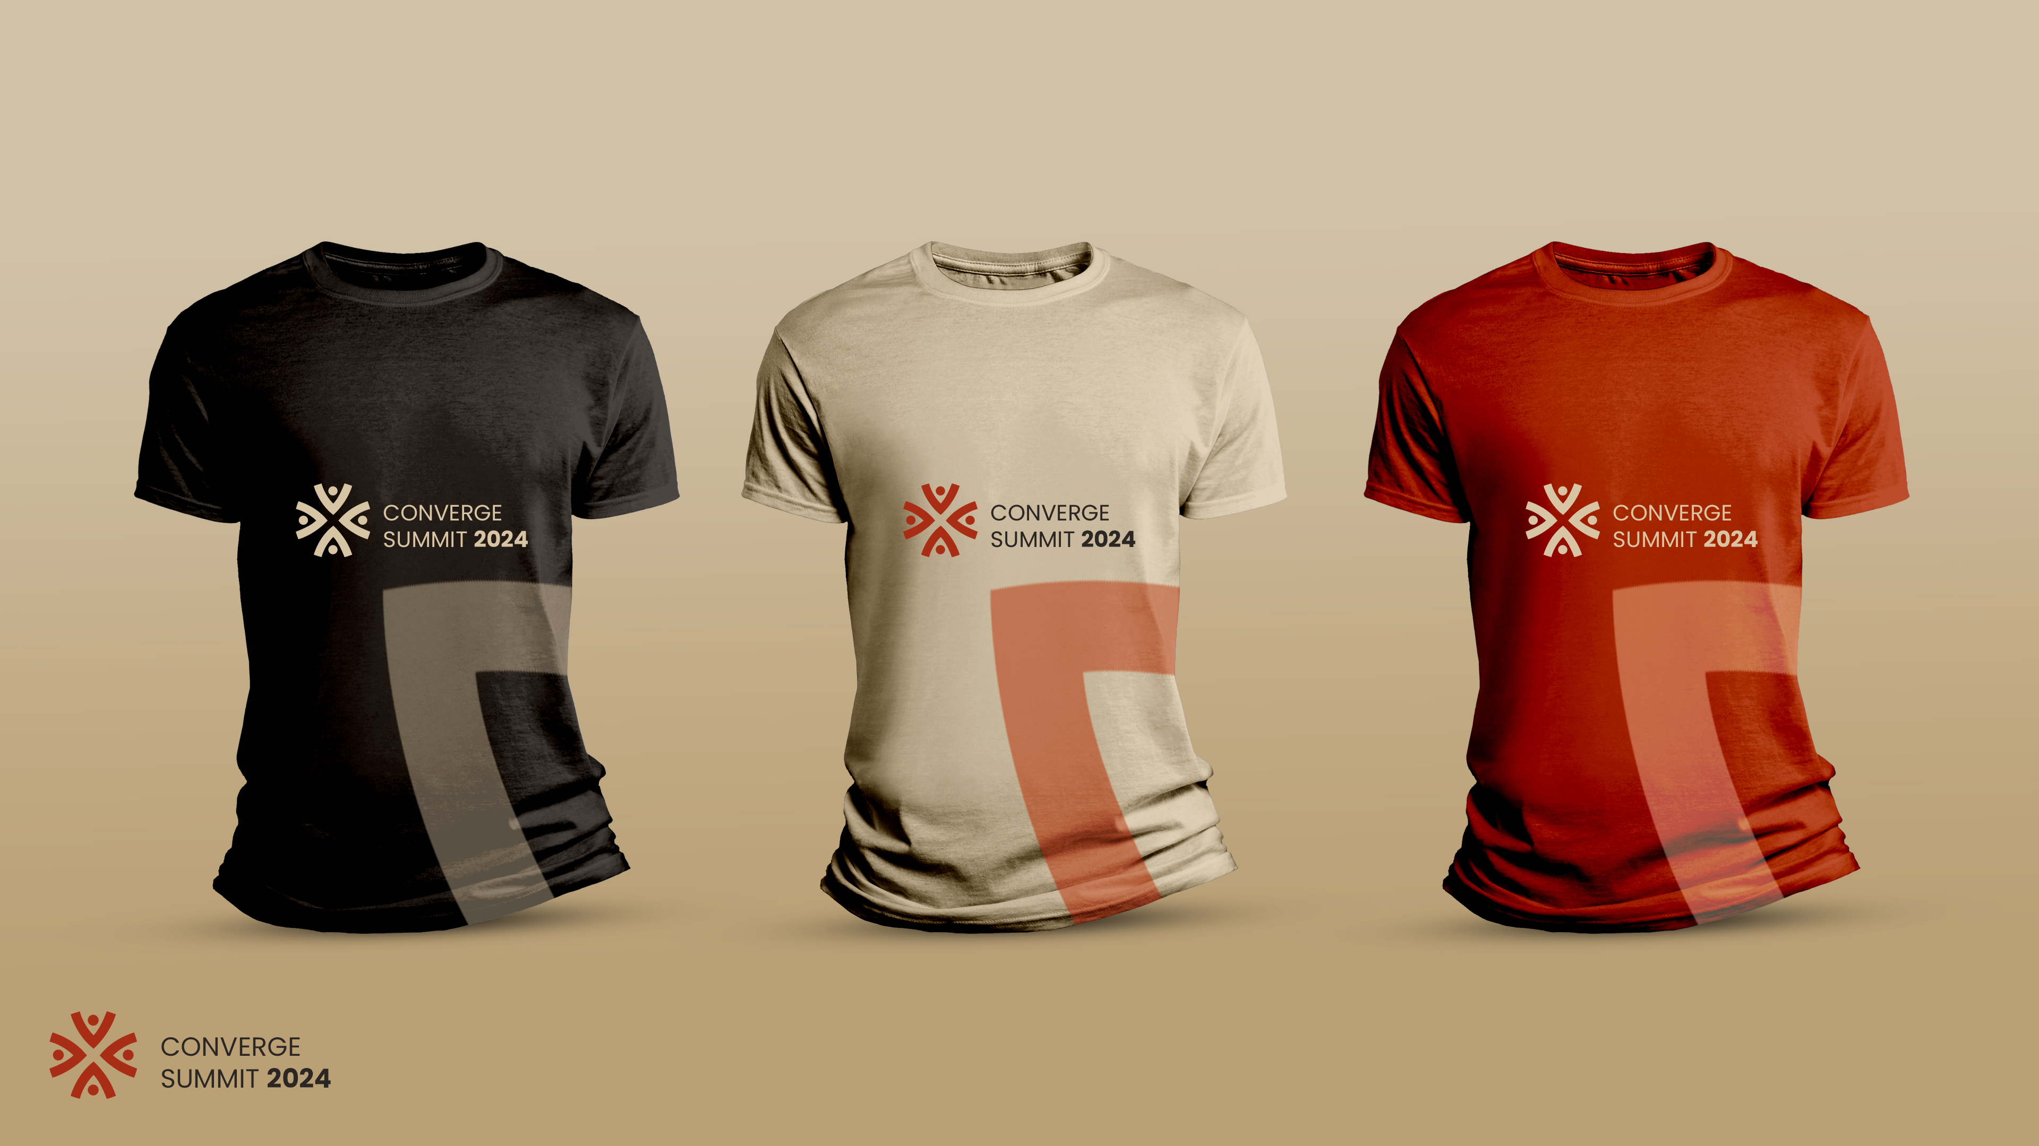

Slide 11
